Slide 1
Introduction to Neural Networks

Slide 2
Deep Learning
This series of lectures will cover key theory aspects:
Neurons and Activation Functions
Cost Functions
Gradient Descent
Backpropagation

Slide 3
Deep Learning
Once we build a general high level understanding we will code out all these topics manually with Python, without the use of a deep learning library.
Then we can move on to using TensorFlow!

Slide 4
Deep Learning
Understanding a high level overview of these key elements will make it much easier to understand what is happening when we begin to use TensorFlow!
Tensorflow has direct connections to these concepts in its syntax!

Slide 5
Let’s get started!

Slide 6
Introduction to the Perceptron

Slide 7
Deep Learning
Before we launch straight into neural networks, we need to understand the individual components first, such as a single “neuron”.

Slide 8
Deep Learning
Artificial Neural Networks (ANN) actually have a basis in biology!
Let’s see how we can attempt to mimic biological neurons with an artificial neuron, known as a perceptron!

Slide 9
Deep Learning
The biological neuron:
Dendrites
Body
Axon

Slide 10
Deep Learning
The artificial neuron also has inputs and outputs!
Input 0
Output
Input 1

Slide 11
Deep Learning
This simple model is known as a perceptron.
Input 0
Output
Input 1

Slide 12
Deep Learning
Simple example of how it can work.
Input 0
Output
Input 1

Slide 13
Deep Learning
We have two inputs and an output
Input 0
Output
Input 1

Slide 14
Deep Learning
Inputs will be values of features
12
Input 0
Output
4
Input 1

Slide 15
Deep Learning
Inputs are multiplied by a weight
12
Weight 0
Input 0
Output
Weight 1
4
Input 1

Slide 16
Deep Learning
Weights initially start off as random
12
Weight 0
Input 0
Output
Weight 1
4
Input 1

Slide 17
Deep Learning
Weights initially start off as random
12
Input 0
0.5
Output
-1
4
Input 1

Slide 18
Deep Learning
Inputs are now multiplied by weights
12
Input 0
0.5
Output
-1
4
Input 1

Slide 19
Deep Learning
Inputs are now multiplied by weights
Input 0
12 * 0.5 = 6
Output
4 * -1 = -4
Input 1

Slide 20
Deep Learning
Then these results are passed to an activation function.
Input 0
12 * 0.5 = 6
Activation
Function
Output
4 * -1 = -4
Input 1

Slide 21
Deep Learning
Many activation functions to choose from, we’ll cover this in more detail later!
Input 0
12 * 0.5 = 6
Activation
Function
Output
4 * -1 = -4
Input 1

Slide 22
Deep Learning
For now our activation function will be very simple...
Input 0
12 * 0.5 = 6
Activation
Function
Output
4 * -1 = -4
Input 1

Slide 23
Deep Learning
If sum of inputs is positive return 1, if sum is negative output 0.
Input 0
12 * 0.5 = 6
Activation
Function
Output
4 * -1 = -4
Input 1

Slide 24
Deep Learning
In this case 6-4=2 so the activation function returns 1.
Input 0
12 * 0.5 = 6
Activation
Function
1
Output
4 * -1 = -4
Input 1

Slide 25
Deep Learning
There is a possible issue. What if the original inputs started off as zero?
Input 0
12 * 0.5 = 6
Activation
Function
1
Output
4 * -1 = -4
Input 1

Slide 26
Deep Learning
Then any weight multiplied by the input would still result in zero!
Input 0
12 * 0.5 = 6
Activation
Function
1
Output
4 * -1 = -4
Input 1

Slide 27
Deep Learning
We fix this by adding in a bias term, in this case we choose 1.
Input 0
12 * 0.5 = 6
Activation
Function
1
4 * -1 = -4
Output
Input 1
+ 1
Bias

Slide 28
Deep Learning
So what does this look like mathematically?
Input 0
12 * 0.5 = 6
Activation
Function
1
4 * -1 = -4
Output
Input 1
+ 1
Bias

Slide 29
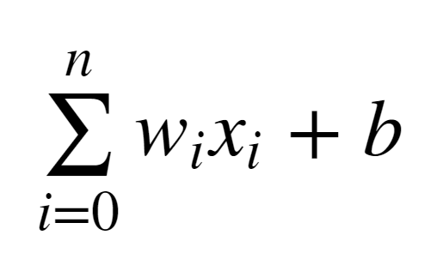
Deep Learning
Let’s quickly think about how we can represent this perceptron model mathematically:

Slide 30
Deep Learning
Once we have many perceptrons in a network we’ll see how we can easily extend this to a matrix form!

Slide 31
Deep Learning
Review
Biological Neuron
Perceptron Model
Mathematical Representation

Slide 32
Introduction to Neural Networks

Slide 33
Deep Learning
We’ve seen how a single perceptron behaves, now let’s expand this concept to the idea of a neural network!
Let’s see how to connect many perceptrons together and then how to represent this mathematically!

Slide 34
Deep Learning
Multiple Perceptrons Network

Slide 35
Deep Learning
Input Layer. 2 hidden layers. Output Layer

Slide 36
Deep Learning
Input Layers
Real values from the data
Hidden Layers
Layers in between input and output
3 or more layers is “deep network”
Output Layer
Final estimate of the output

Slide 37
Deep Learning
As you go forwards through more layers, the level of abstraction increases.
Let’s now discuss the activation function in a little more detail!

Slide 38
Deep Learning
Previously our activation function was just a simple function that output 0 or 1.
1
Output
0
0
z = wx + b

Slide 39
Deep Learning
This is a pretty dramatic function, since small changes aren’t reflected.
1
Output
0
0
z = wx + b

Slide 40
Deep Learning
It would be nice if we could have a more dynamic function, for example the red line!
1
Output
0
0
z = wx + b

Slide 41
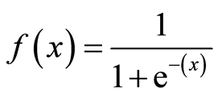
Deep Learning
Lucky for us, this is the sigmoid function!
1
Output
0
0
z = wx + b

Slide 42
Deep Learning
Changing the activation function used can be beneficial depending on the task!
1
Output
0
0
z = wx + b

Slide 43
Deep Learning
Let’s discuss a few more activation functions that we’ll encounter!
1
Output
0
0
z = wx + b

Slide 44
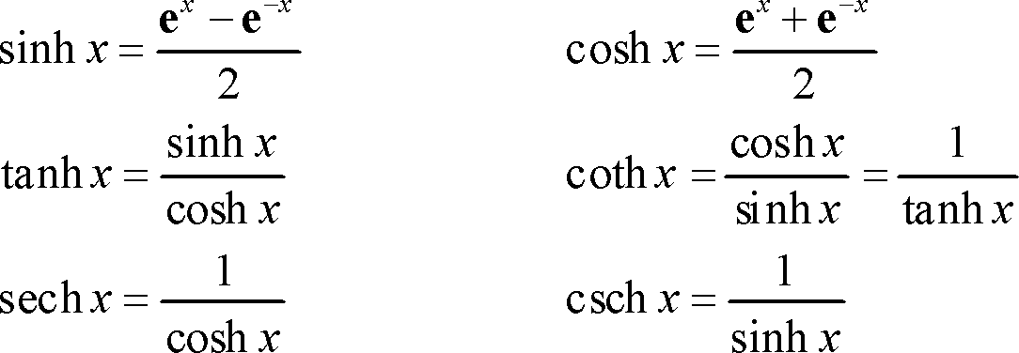
Deep Learning
Hyperbolic Tangent: tanh(z)
1
Output
-1
0
z = wx + b

Slide 45
Deep Learning
Rectified Linear Unit (ReLU): This is actually a relatively simple function: max(0,z)
Output
0
z = wx + b

Slide 46
Deep Learning
ReLu and tanh tend to have the best performance, so we will focus on these two.
Deep Learning libraries have these built in for us, so we don’t need to worry about having to implement them manually!

Slide 47
Deep Learning
As we continue on, we’ll also talk about some more state of the art activation functions.
Up next, we’ll discuss cost functions, which will allow us to measure how well these neurons are performing!

Slide 48
Cost Functions

Slide 49
Deep Learning
Let’s now explore how we can evaluate performance of a neuron!
We can use a cost function to measure how far off we are from the expected value.

Slide 50
Deep Learning
We’ll use the following variables:
y to represent the true value
a to represent neuron’s prediction
In terms of weights and bias:
w*x + b = z
Pass z into activation function σ(z) = a

Slide 51
Deep Learning
Quadratic Cost
C = Σ(y-a)² / n
We can see that larger errors are more prominent due to the squaring.
Unfortunately this calculation can cause a slowdown in our learning speed.

Slide 52
Deep Learning
Cross Entropy
C = (-1/n) Σ (y⋅ln(a) + (1-y)⋅ln(1-a)
This cost function allows for faster learning.
The larger the difference, the faster the neuron can learn.

Slide 53
Deep Learning
We now have 2 key aspects of learning with neural networks, the neurons with their activation function and the cost function.
We’re still missing a key step, actually “learning”!

Slide 54
Deep Learning
We need to figure out how we can use our neurons and the measurement of error (our cost function) and then attempt to correct our prediction, in other words, “learn”!

Slide 55
Deep Learning
In the next lecture we’ll briefly cover how we can do this with Gradient Descent!

Slide 56
Gradient Descent and Backpropagation

Slide 57
Deep Learning
If you’ve dabbled in machine learning before, you may have already heard of Gradient Descent!
Let’s quickly go over it with a high level overview!

Slide 58
Deep Learning
Gradient descent is an optimization algorithm for finding the minimum of a function.
To find a local minimum, we take steps proportional to the negative of the gradient.

Slide 59
Deep Learning
Gradient Descent (in 1 dimension)
C
w

Slide 60
Deep Learning
Gradient Descent (in 1 dimension)
C
w

Slide 61
Deep Learning
Gradient Descent (in 1 dimension)
C
w

Slide 62
Deep Learning
Gradient Descent (in 1 dimension)
C
w

Slide 63
Deep Learning
Visually we can see what parameter value to choose to minimize our Cost!
C
w

Slide 64
Deep Learning
Finding this minimum is simple for 1 dimension, but our cases will have many more parameters, meaning we’ll need to use the built-in linear algebra that our Deep Learning library will provide!

Slide 65
Deep Learning
Using gradient descent we can figure out the best parameters for minimizing our cost, for example, finding the best values for the weights of the neuron inputs.

Slide 66
Deep Learning
We now just have one issue to solve, how can we quickly adjust the optimal parameters or weights across our entire network?
This is where backpropagation comes in!

Slide 67
Deep Learning
Backpropagation is used to calculate the error contribution of each neuron after a batch of data is processed.
It relies heavily on the chain rule to go back through the network and calculate these errors.

Slide 68
Deep Learning
Backpropagation works by calculating the error at the output and then distributes back through the network layers.
It requires a known desired output for each input value (supervised learning).

Slide 69
Deep Learning
The implementation of backpropagation will be further clarified when we dive into the math example!
For now let’s finish off our high level discussion with TensorFlow’s playground!

Slide 70
TensorFlow Playground

Slide 71
Deep Learning
Go to:
playground.tensorflow.org

Slide 72
Manual Neural Network Part 2 - Operation

Slide 73
Deep Learning
Operation Class
Input Nodes
Output Nodes
Global Default Graph Variable
Compute
Overwritten by extended classes

Slide 74
Deep Learning
Graph - A global variable
Constant
n1
1
Constant
Operation
2
n2
n3

Slide 75
Deep Learning
Graph
Constant
n1
1
Constant
Add(Operation)
2
n2
n3
3

Slide 76
Deep Learning
Graph
Constant
n1
1
Constant
Multiply(Operation)
2
n2
n3
2

Slide 77
Manual Neural Network Variables,Placeholders, and Graphs

Slide 78
Deep Learning
Placeholder - An “empty” node that needs a value to be provided to compute output.
Variables - Changeable parameter of Graph
Graph - Global Variable connecting variables and placeholders to operations.

Slide 79
Let’s get started!

Slide 80
Manual Neural Network Session

Slide 81
Deep Learning
Now that the Graph has all the nodes, we need to execute all the operations within a Session.
We’ll use a PostOrder Tree Traversal to make sure we execute the nodes in the correct order.

Slide 82
Manual Neural Network Classification

Slide 83
Deep Learning
y = mx + b
y = -1x + 5
Remember that both y and x are features!
Feat2 = -1*Feat1 + 5
Feat2 + Feat1 - 5 = 0
FeatMatrix[ 1, 1] - 5 = 0

